Slide 1
Web Scraping Seek.com.au
By Elke Hansen

Slide 2
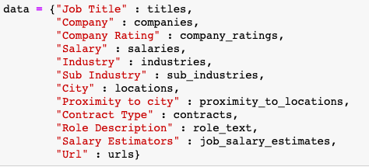
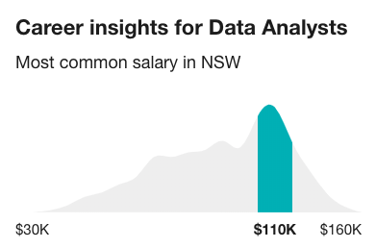
Scraping Selections
Selected Seek for range of variables and the salary estimation segment
Started with 20 pages and used those to work through the different variations within each job
Used requests for all except for the salary estimator which could only be found using Selenium

Slide 3
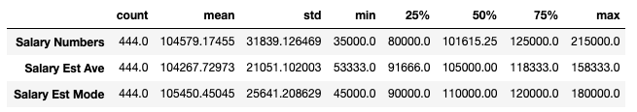
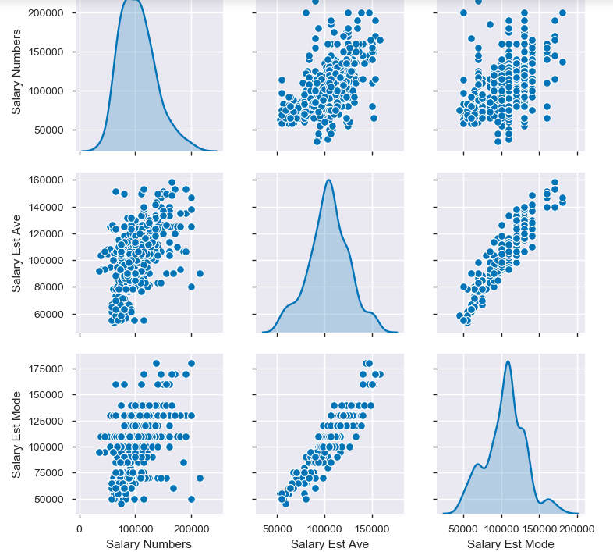
Imputing Salary
Only 447 annual salaries extracted ~10% of the overall data
Salary Estimators: a range of 2 to 3 values that represent the min, mode and max of salary estimate
Based on Seek's own salary prediction model which is based on other roles with the same or similar job title within the same city
I selected the mean estimator as my target

Slide 4
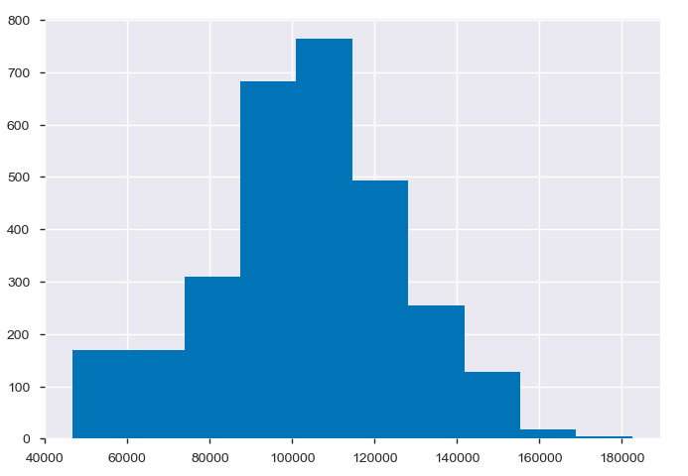
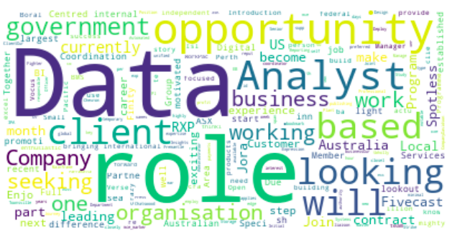
Trial and Error in Modelling Salary
Started with just Role Description column:
Linear Models: None could get an accuracy of 50%
Bucketing Salary: 5 categories, best model a logistic regression with an F1 score of 56.8% compared to baseline of 36.1%
Combining all Text columns: Improved my best two models to 62% (logistic regression) and 63% (linear SVC)
Feature Reduction: Trialled Truncated SVC and Select K Best (chi-squared) but neither of these improved the model at all

Slide 5
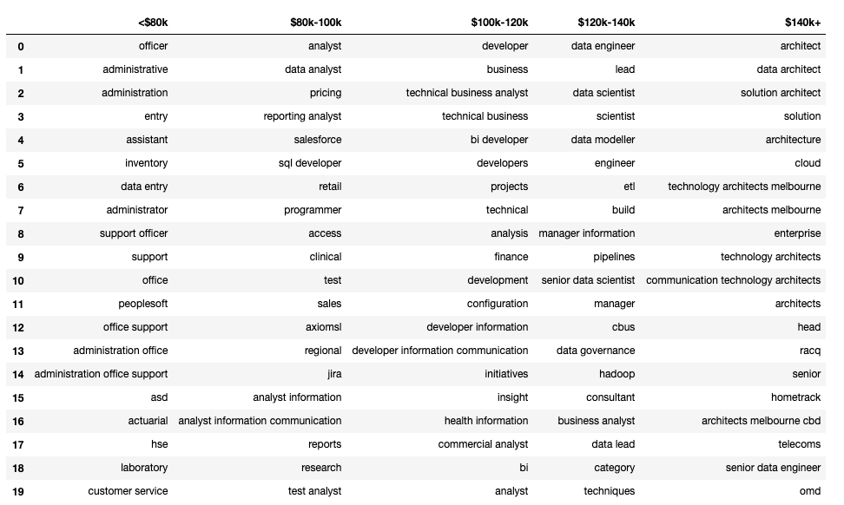
Final Model - Linear SVC : 63% accuracy
Trends in buckets:
* <$80k : office and admin support roles
* $80k - 100k : data analyst roles, interestingly also the word regional is included in here, which was the extra category I created to describe anything not within major capital cities
* $100k - $120k : business analyst and development type roles
* $120k - $140k : data scientist and management roles
* $140k + : data architect and cloud solutions roles

Slide 6
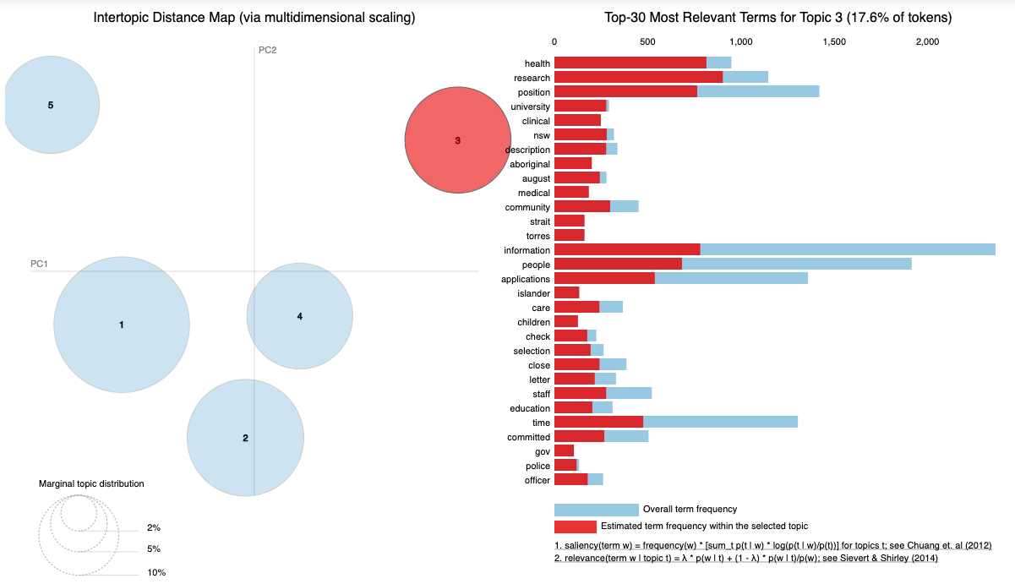
Latent Dirichlet Allocation Topic Model
Creation of LDA model to make a target variable
In this you can see that there are 5 distinct topic areas within the Role Description Column
Used this to create a model to try and predict these topics using the Job Title and Industry information

Slide 7
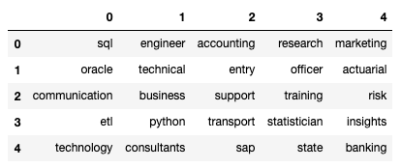
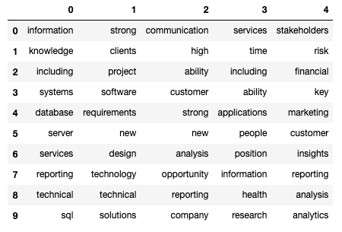
Job Title Categories
Job Title Top Features
Best model was a logistic regression with a TFIDF Transformer producing an accuracy of 63% compared to baseline of 32.3%
Compared the Job Title Top features to the Role description top features of each topic
Initially looked much worse but changed the cvec max_df from 0.8 to 0.5 and it improved all models by 2% while also making the role description more varied
Corresponding Role Description Features

Slide 8
Thank You!

